Slide 1
Photo-mask Making & Direct writing

Slide 2
Photo-mask Making & Direct writing
Electron Beam Lithography (EBL)
Ion Beam Lithography
Laser Direct Write (Visible & UV)
Femtosecond laser lithography (IR)

Slide 3
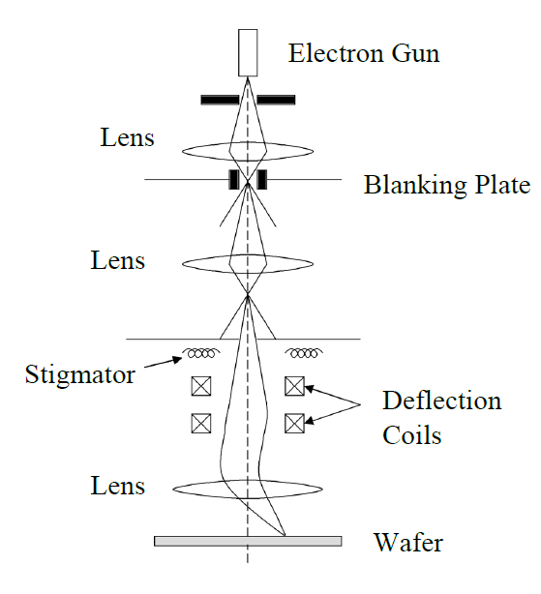
Electron Beam Lithography System
Using the Electrons for making mask and reticles
Small wavelength results the Smallest geometry

Slide 4
Electron Beam Lithography System
Diffraction is not a limitation on resolution (λ < 1 Å for 10-50 keV electrons)
Resolution depends on electron scattering and beam optics the size of the beam, can reach ~ 5 nm
Two modes of operation:
  Direct writing with narrow beam
  Electron projection lithography using a mask :EPL
Issues:
  Throughput of direct writing is very low : research tool or low pattern density manufacturing
  Projection stepper (EPL) is in development stage only (primarily by Nikon).
  Mask making is the biggest challenge for the projection method
  Back-scattering and second electron result in proximity effect –reduce resolution with dense patterns there is also the proximity effect
  Operates in high vacuum (10⁻⁶ –10⁻¹⁰ torr) –slow and expensive

Slide 5
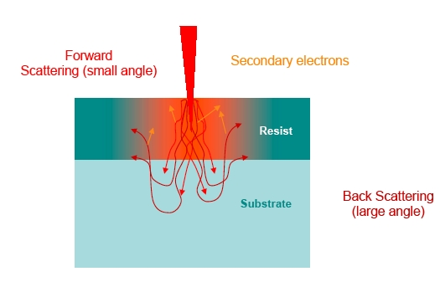
Electron Beam Lithography System
Electron scattering in resist and substrate
The scattered electrons also expose the resist
Interaction of e-and substrate + resist leads to beam spreading
  Elastic and in-elastic scattering in the resist
  Back-scattering from substrate and generation of secondary e-
  100 Å e-beam become 0.2 µm line

Slide 6

Ion Beam Lithography
Ion source
Ions scatter much less than electrons so a higher resolution is feasible
Problems:
  Ion Beam source (e.g. Gallium)
  Beam forming
  Not as full-grown as EBL
Ion beam
Mask
Electrostatic lens system
(4:1 reduction)
Reference plate
Step-and-scan wafer stage
Vacuum chamber

Slide 7
Ion Beam Lithography
Can achieve higher resolution
Direct writing
Direct ion implantation and ion beam sputtering patterned etch
Serial writing, low throughput
Unlikely will be used in the mass production
Mask and reticle repairing
IC device defect detection and repairing

Slide 8
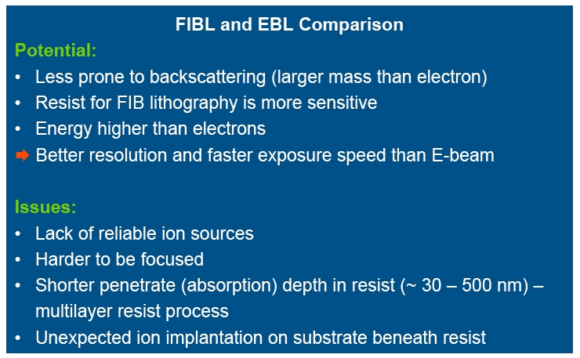
Ion Beam Lithography

Slide 9
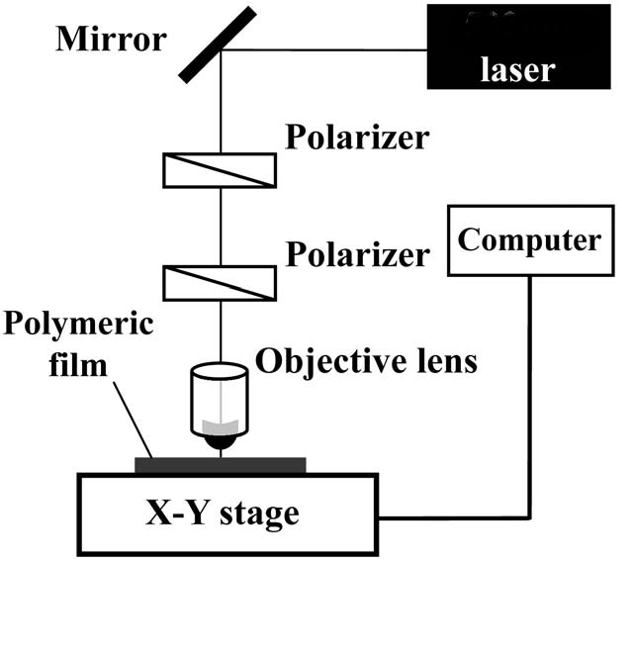
Laser Lithography
Easy to use
Easy maintenance
Home-made systems with acceptable Features
Low-cost method
Different wavelengths for different photoresist
Direct Writing on photo-sensitive materials
No need to vacuum

Slide 10
Laser Lithography
Minimum feature size: ~ 2 μm
Diffraction limitation
Throughput of direct writing is low
Mask making
Research application
DUV wavelength laser is not Available

Slide 11
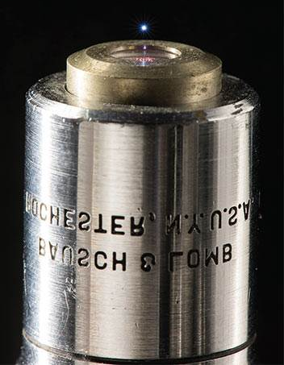
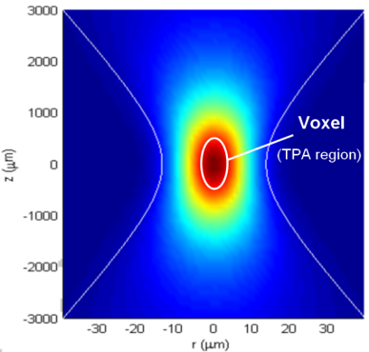
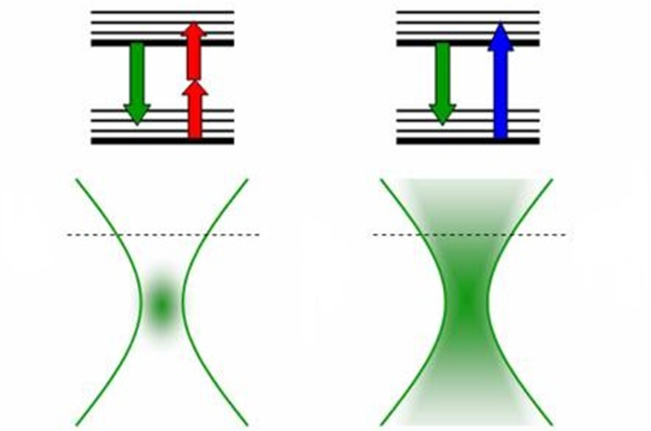
Two photon polymerization (TPP) lithography
Two Photon Absorption
IR Laser Writing!
Femto-Second laser Sources

Slide 12
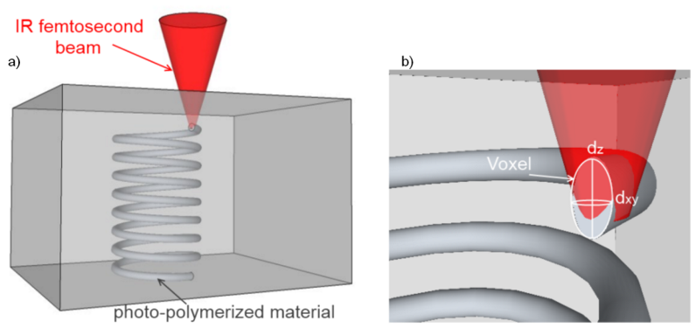
Two photon polymerization (TPP) lithography
3 Dimensional lithography
Without diffraction limit
The quality is comparable to EBL
Direct micro-Ablation

Slide 13
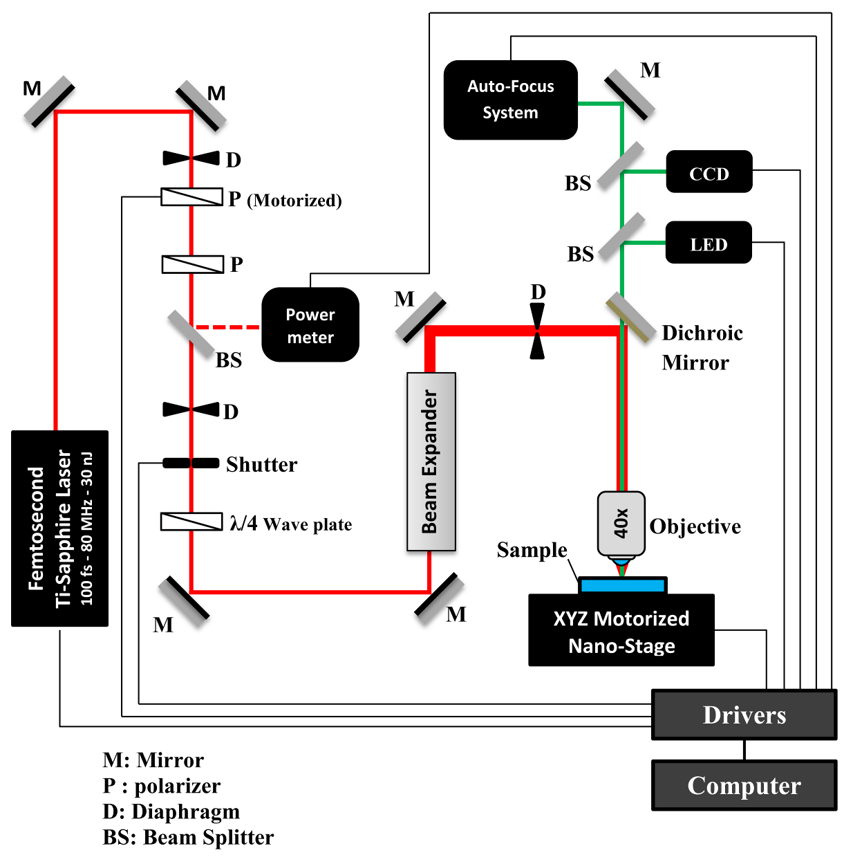

Slide 14
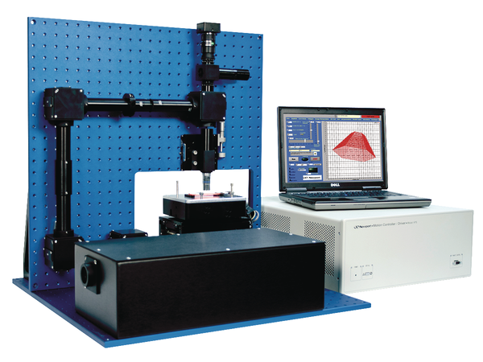
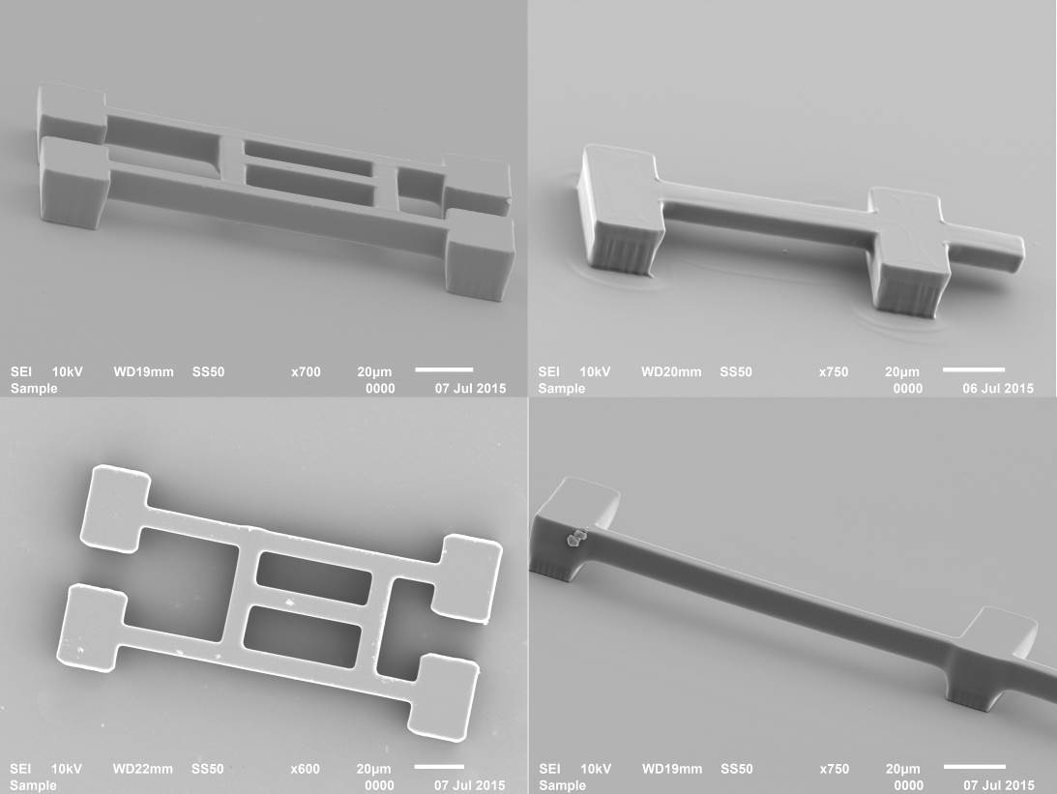
Two photon polymerization (TPP) lithography

Slide 15
